Slide 1
HTML

Slide 2
Outline
Introduction
Basics
Elements
Attributes
Paragraphs
Styles & Formatting
Colors (RGB, HEX, HSL)
Links / Charset
Images
Tables
Lists
Block & Inline
Class, ID
Layout Elements
Responsive Web Design
Multimedia
HTML Forms

Slide 3
HTML INTRODUCTION
1
The Structure

Slide 4

HTML
HTML is the standard markup language for creating Web pages.

Slide 5
HTML was created by Sir Tim Berners-Lee in late 1991 but was not officially released.
It was published in 1995 as HTML 2.0. HTML 4.01 was published in late 1999 and was a major version of HTML.
HTML is a very evolving markup language and has evolved with various versions updating.

Slide 6
Alternatives to HTML
XML
XML stands for eXtensible Markup Language
XML is a markup language much like HTML
XML was designed to store and transport data
XML was designed to be self-descriptive
XML is a W3C Recommendation

Slide 7
Then Why HTML ?
One of the biggest advantages of HTML over XML is that Appearance and Presentation can be modified using HTML, which makes it more interactive.
It has its own pre-defined tags and it is not necessary to have closing tags while it is necessary to have closing tags in XML.
XML only focusses on the exchange of information.

Slide 8
What is HTML ?
HTML stands for Hyper Text Markup Language
HTML is the standard markup language for creating Web pages
HTML describes the structure of a Web page
HTML consists of a series of elements
HTML elements tell the browser how to display the content
HTML elements label pieces of content such as "this is a heading", "this is a paragraph", "this is a link", etc.

Slide 9
Example of HTML Page Structure
<!DOCTYPE html> <html> <head> <title>Page Title</title> </head> <body> <h1>My First Heading</h1> <p>My first paragraph.</p> </body> </html>

Slide 10
HTML BASICS
2

Slide 11
HTML Documents
All HTML documents must start with a document type declaration: !DOCTYPE
The HTML document itself begins with <html> and ends with </html>
The visible part of the HTML document is between <body> and </body>

Slide 12
HTML ELEMENTS
3

Slide 13
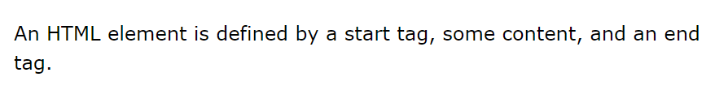
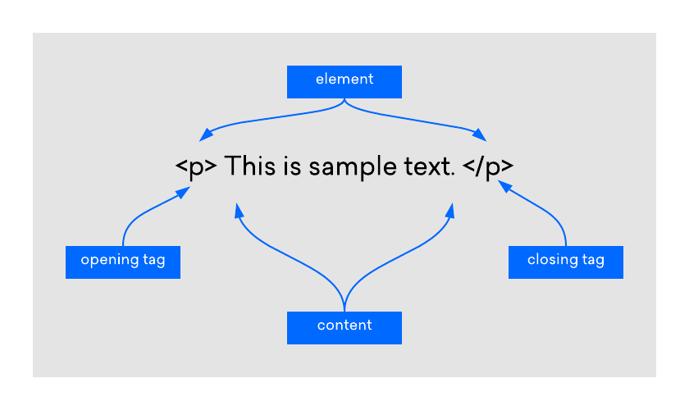
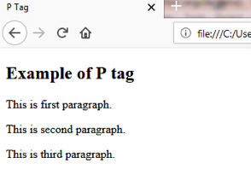
HTML ELEMENTS

Slide 14
HTML ELEMENTS
HTML elements are individual components of HTML defined by HTML tags.
At first glance, elements and tags can easily be mistaken for the same thing. But they are not.
The key thing to remember is that elements are made up of tags, but tags are not made up of elements.

Slide 15
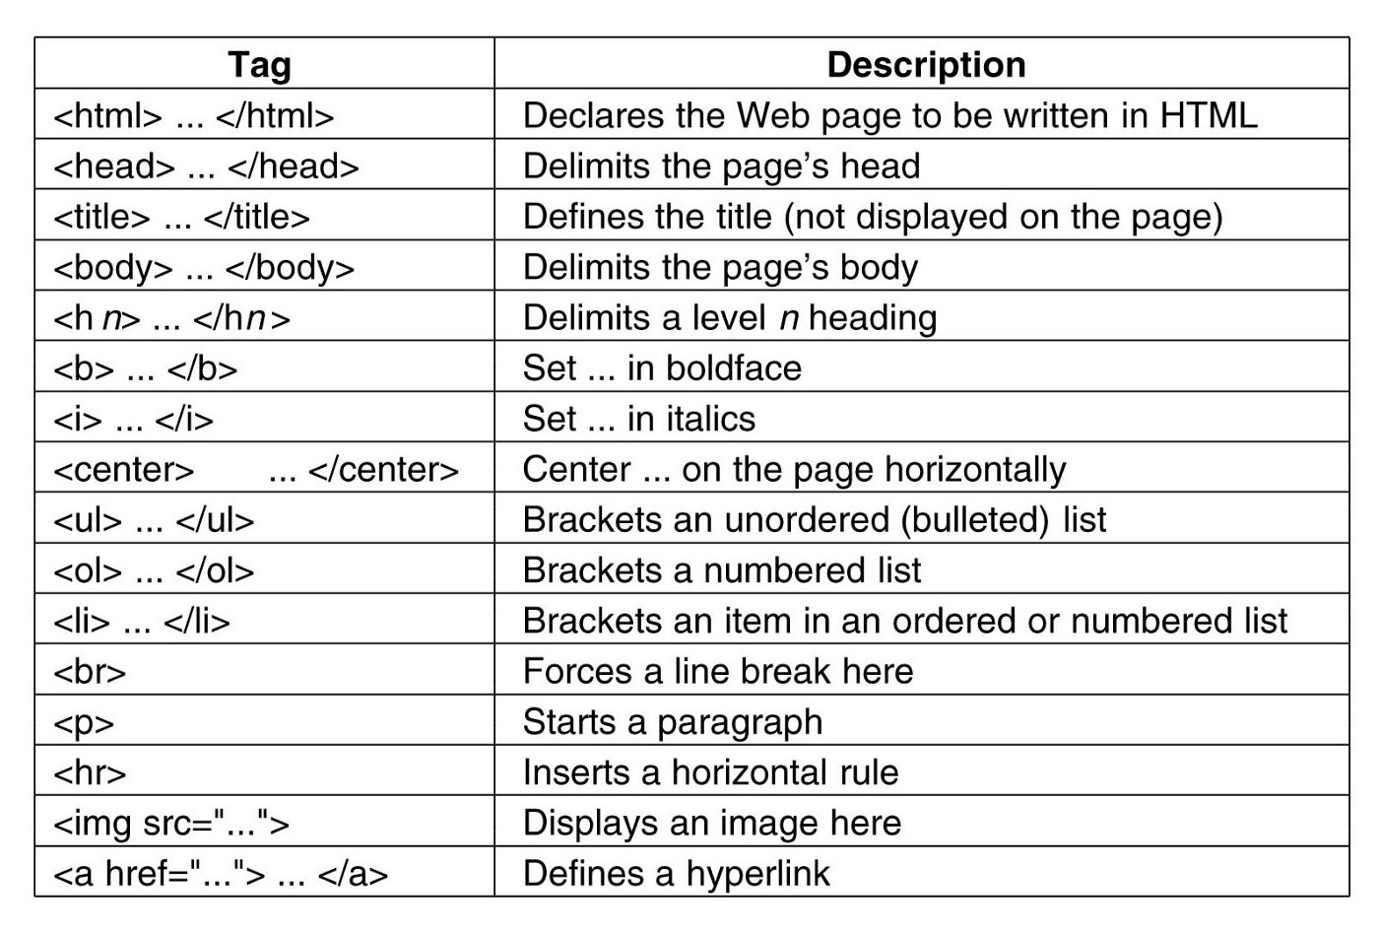
HTML ELEMENTS

Slide 16
HTML ATTRIBUTES
4

Slide 17
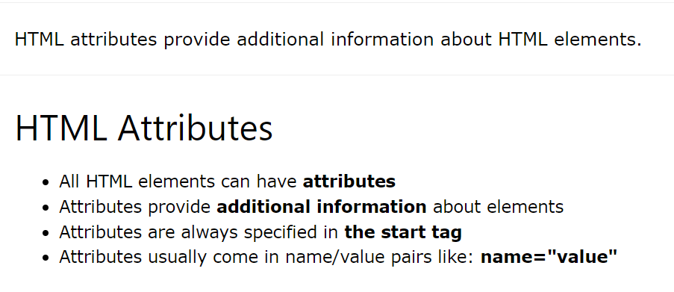
HTML ATTRIBUTES

Slide 18
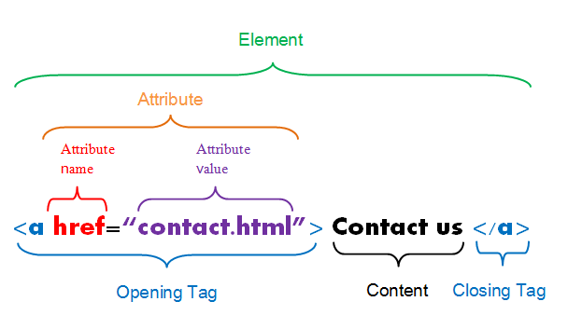
HTML ATTRIBUTES

Slide 19
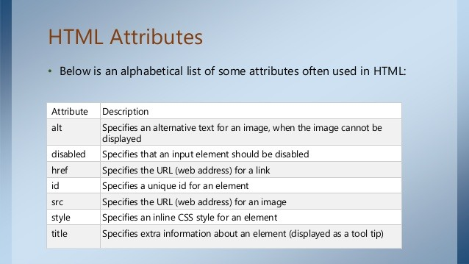
HTML ATTRIBUTES

Slide 20
HTML PARAGRAPHS
5

Slide 21
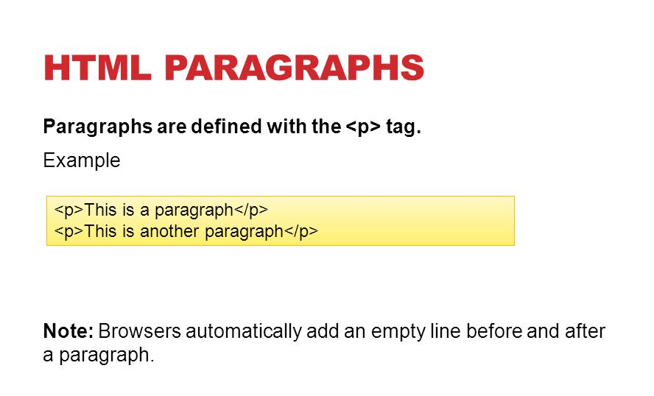
HTML PARAGRAPHS

Slide 22
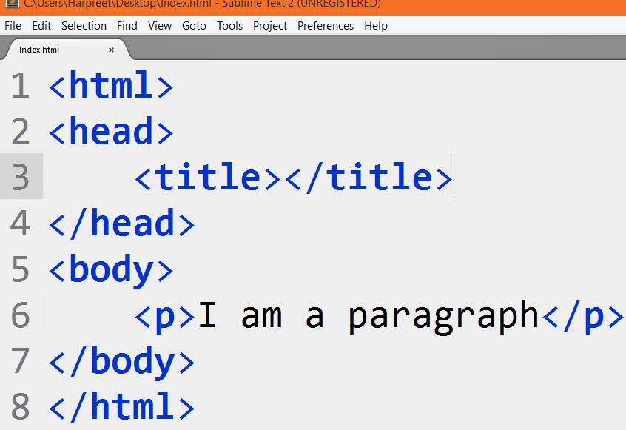
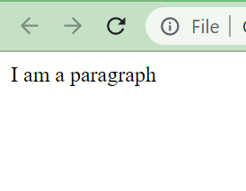
HTML PARAGRAPHS
Example :

Slide 23
HTML Formatting
6

Slide 24

HTML Formatting

Slide 25
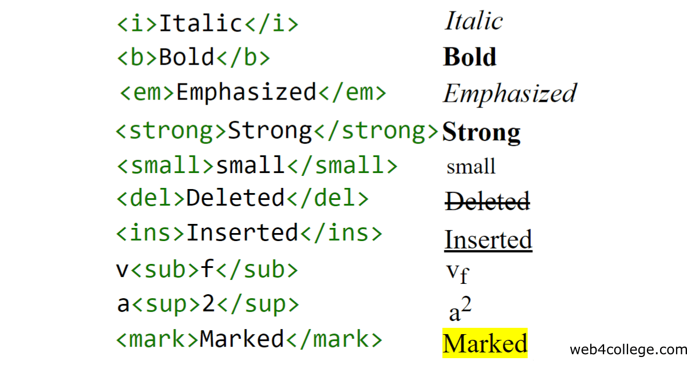
HTML Formatting
HTML contains several elements for defining text with a special meaning.

Slide 26
HTML Links & CharSet
7

Slide 27
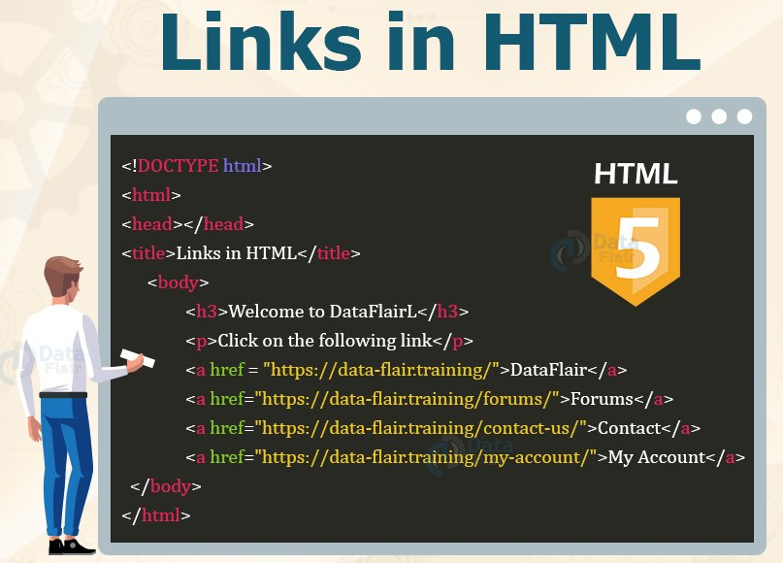
HTML Links
Links are found in nearly all web pages.
Links allow users to click their way from page to page.

Slide 28
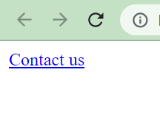
HTML Links
Example :

Slide 29
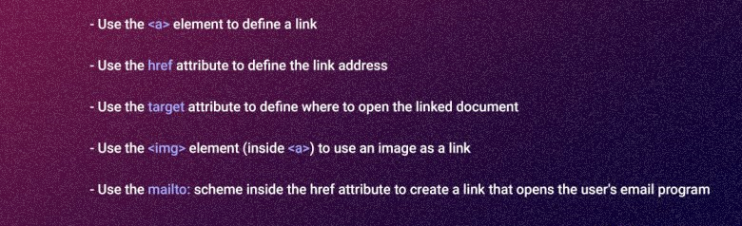
HTML Links

Slide 30
HTML Charset
The HTML5 specification encourages web developers to use the UTF-8 character set.
It covers almost all of the characters and symbols in the world!

Slide 31
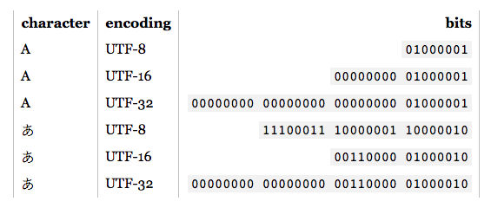
HTML Charset

Slide 32
HTML Images
8

Slide 33
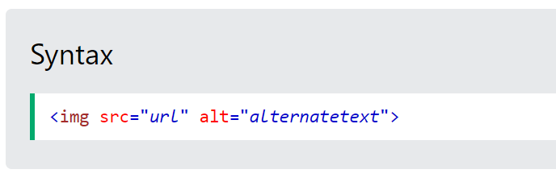
HTML Images
The HTML <img> tag is used to embed an image in a web page.
Images are not technically inserted into a web page; images are linked to web pages.
The <img> tag creates a holding space for the referenced image.
The <img> tag is empty, it contains attributes only, and does not have a closing tag.
The <img> tag has two required attributes:
src - Specifies the path to the image
alt - Specifies an alternate text for the image

Slide 34
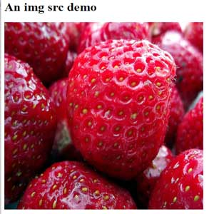
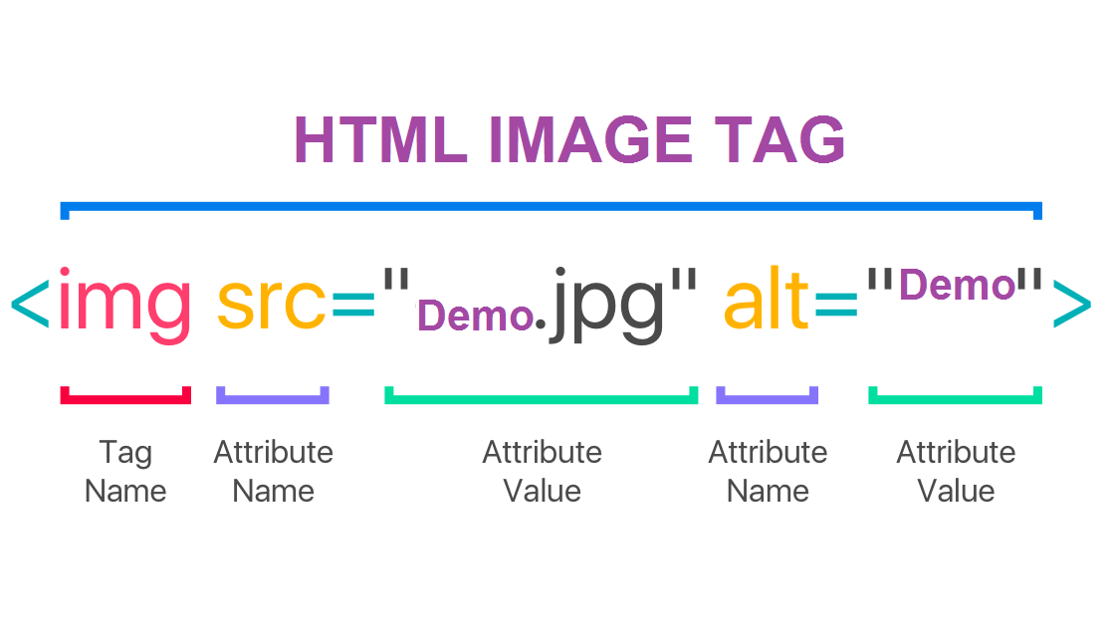
HTML Images

Slide 35
HTML Tables
9

Slide 36
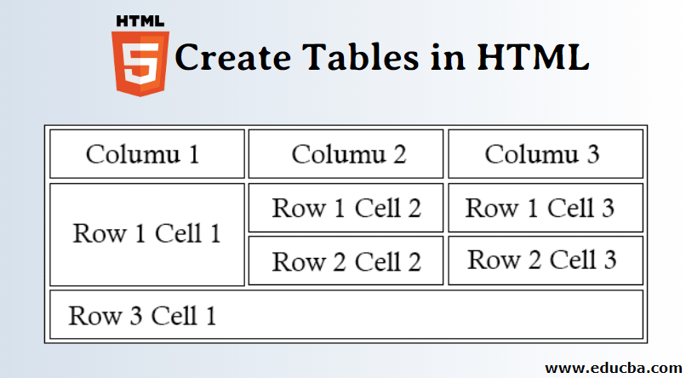
HTML Tables

Slide 37
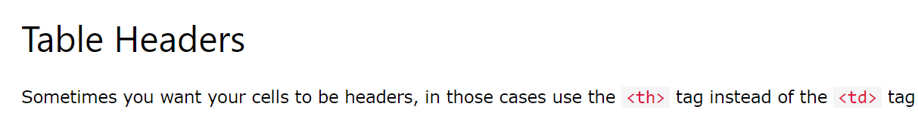
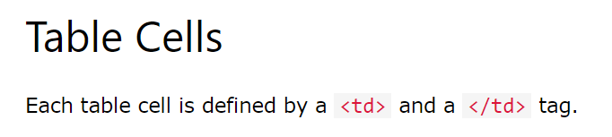
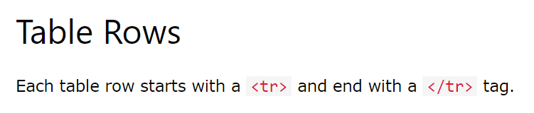
HTML Tables

Slide 38
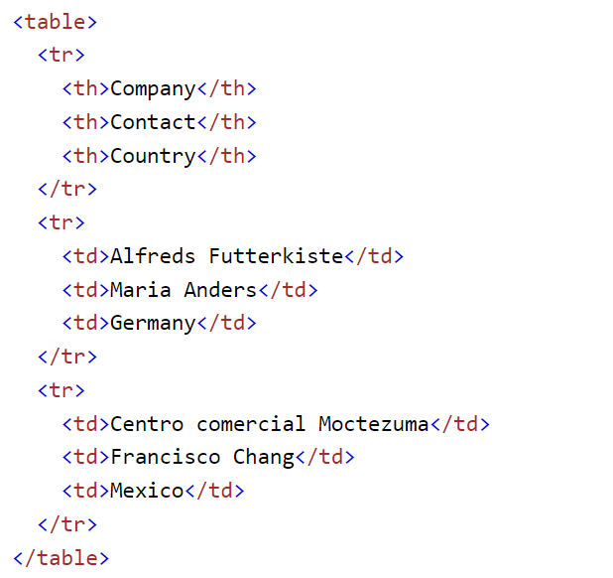
HTML Tables
HTML tables allow web developers to arrange data into rows and columns.

Slide 39
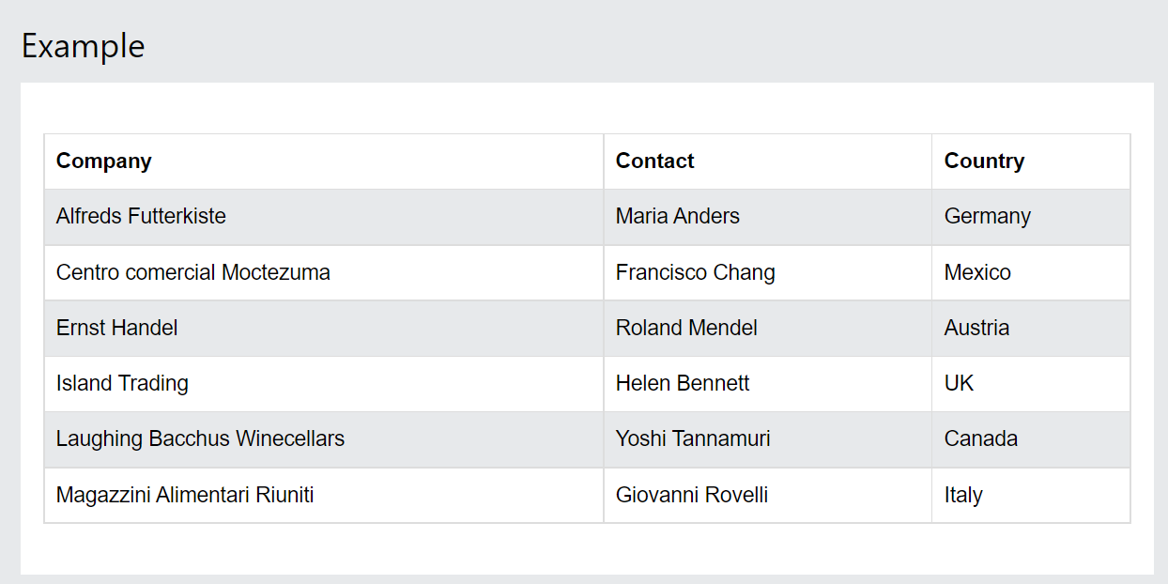
HTML Tables
Example :

Slide 40
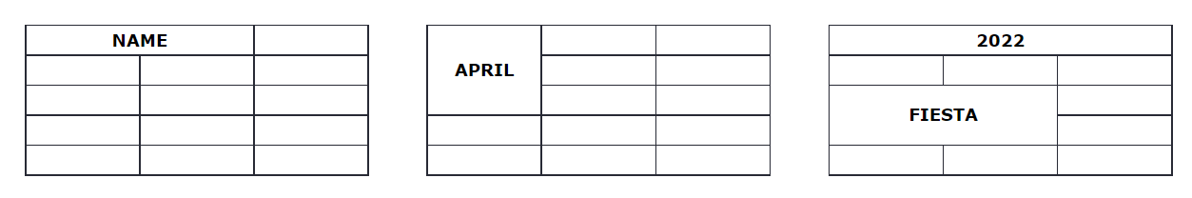
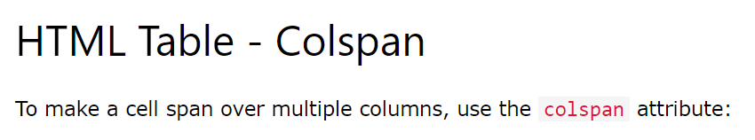
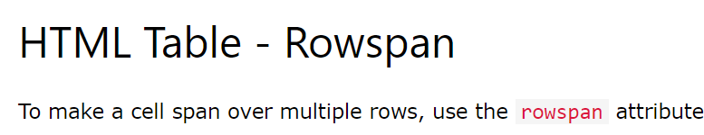
HTML Tables

Slide 41
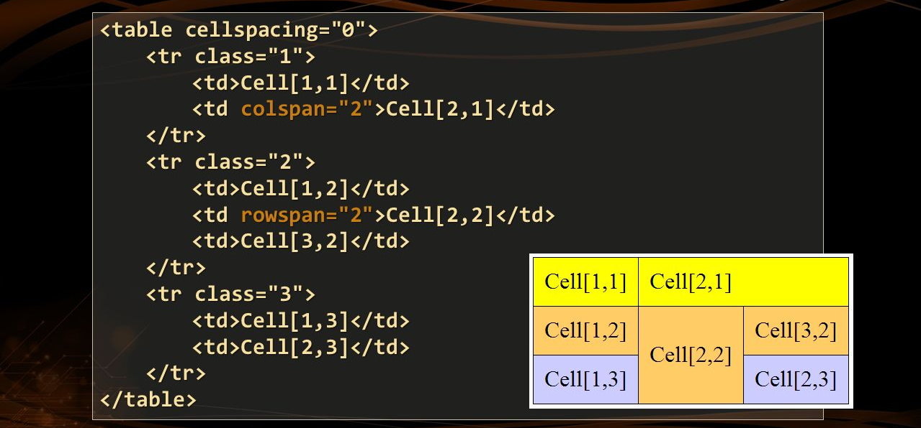
HTML Tables
Example :

Slide 42
HTML Lists
10

Slide 43
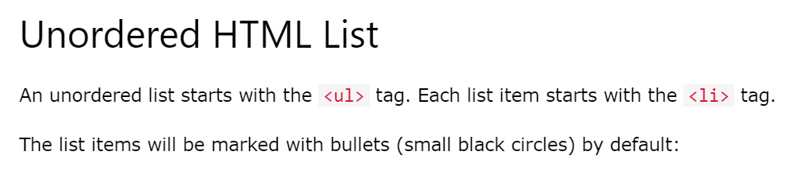
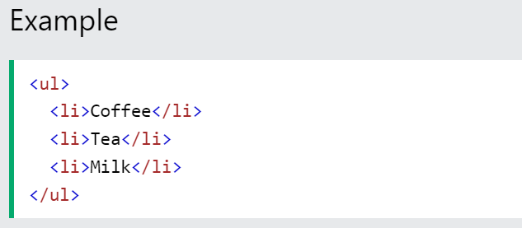
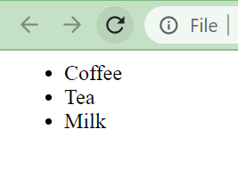
HTML ATTRIBUTES

Slide 44
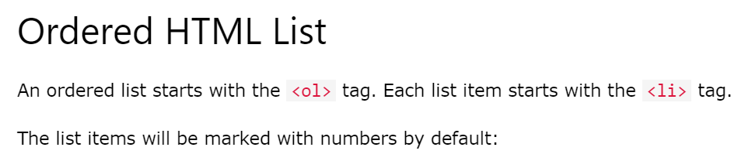
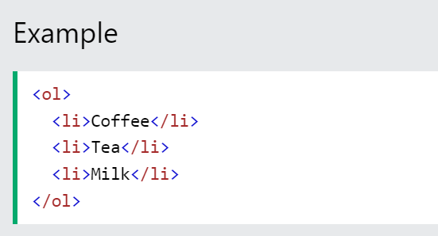
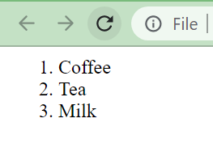
HTML ATTRIBUTES

Slide 45
HTML Block and Inline elements
11

Slide 46
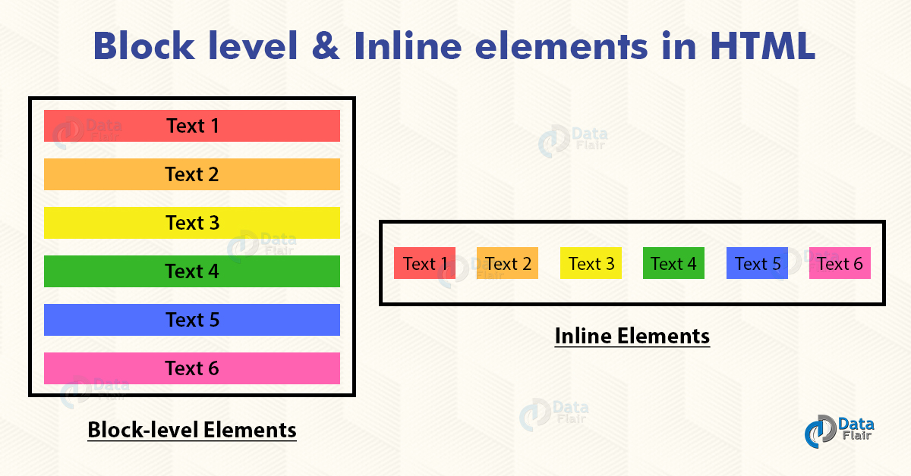
Block & Inline elements

Slide 47
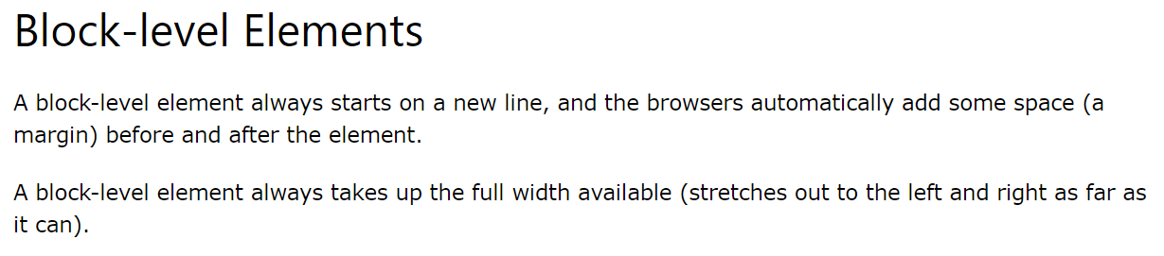
Block & Inline elements

Slide 48
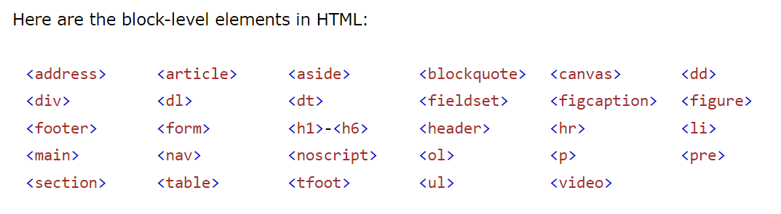
Block & Inline elements

Slide 49
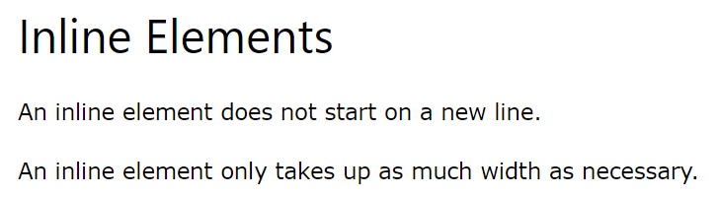
Block & Inline elements

Slide 50
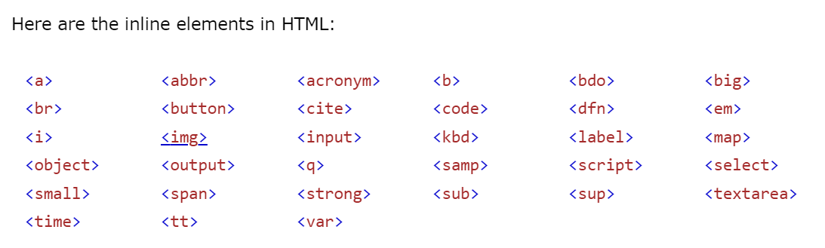
Block & Inline elements

Slide 51
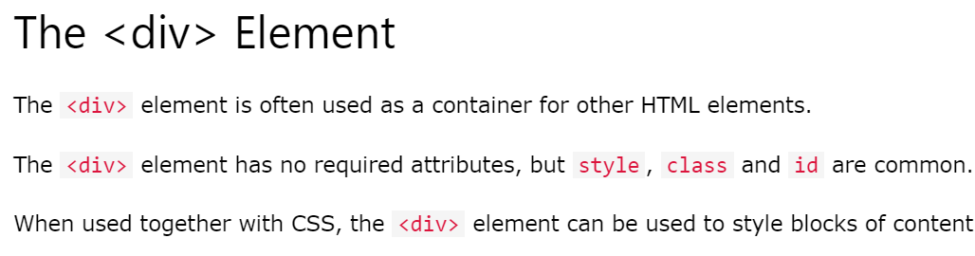
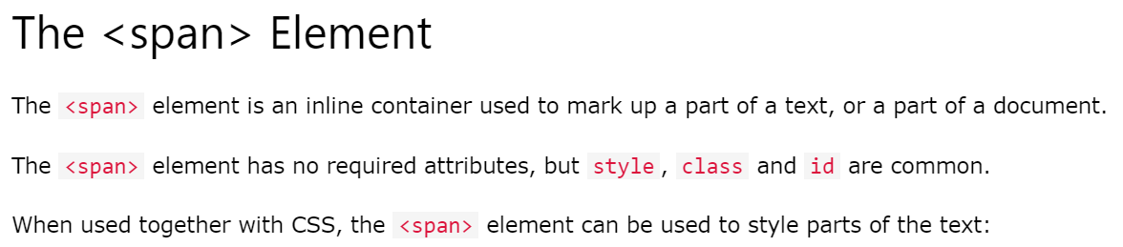
Block & Inline elements

Slide 52
HTML Class and ID
12

Slide 53
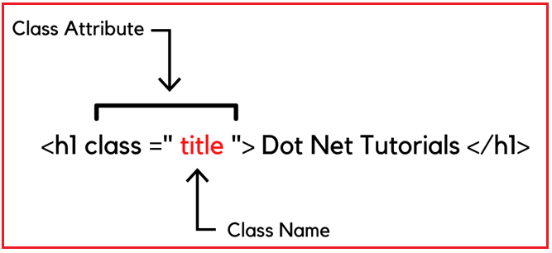
Class
The HTML class attribute is used to specify a class for an HTML element.
Multiple HTML elements can share the same class.

Slide 54
Class
Tip: The class attribute can be used on any HTML element.
Note: The class name is case sensitive!

Slide 55
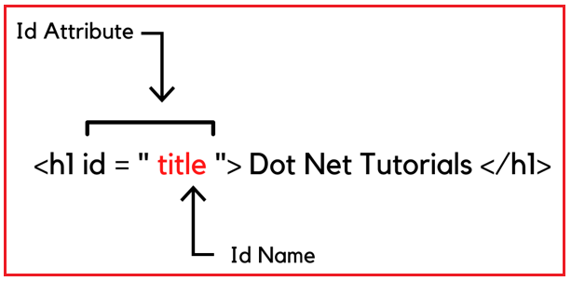
ID
The HTML id attribute is used to specify a unique id for an HTML element.
You cannot have more than one element with the same id in an HTML document.

Slide 56
ID
Note: The id name is case sensitive!
Note: The id name must contain at least one character, cannot start with a number, and must not contain whitespaces (spaces, tabs, etc.).

Slide 57
HTML Block and Inline elements
13

Slide 58
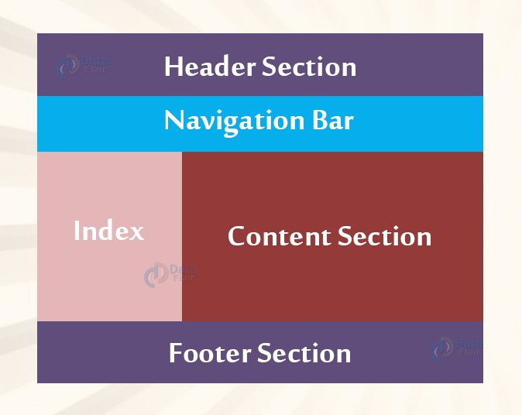
HTML Layout Elements
Websites often display content in multiple columns (like a magazine or a newspaper).

Slide 59
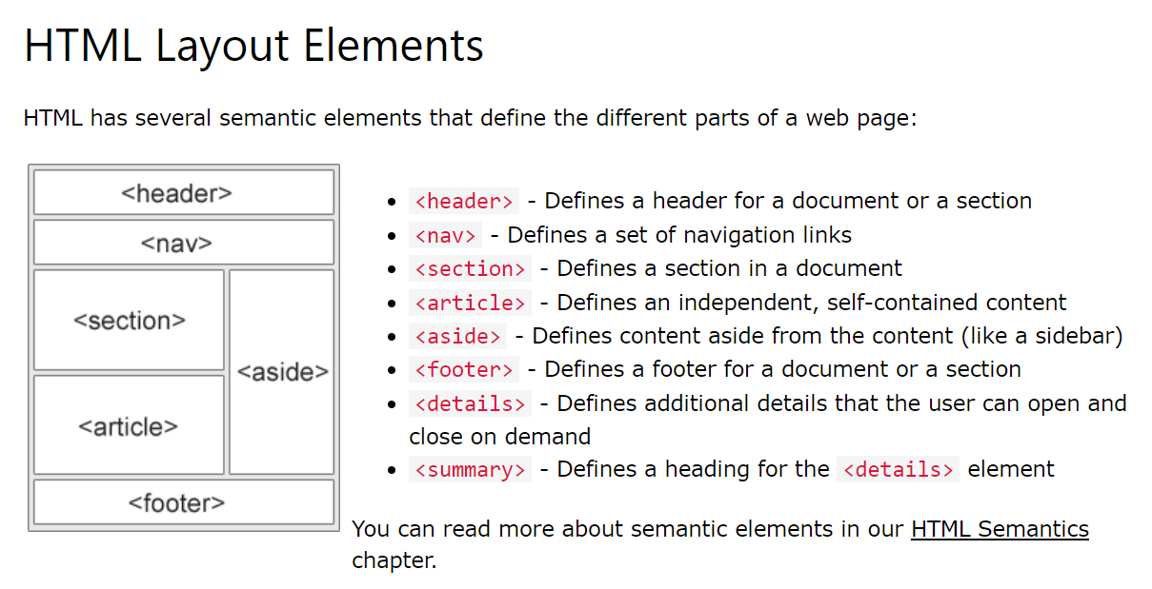
HTML Layout Elements

Slide 60
HTML Responsive Web Design
14

Slide 61
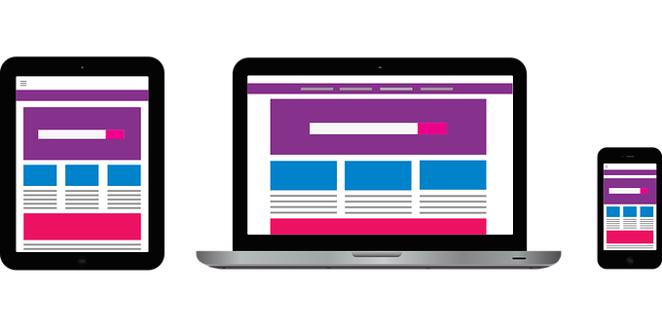
Responsive Web Design
Responsive web design is about creating web pages that look good on all devices!
A responsive web design will automatically adjust for different screen sizes and viewports.

Slide 62
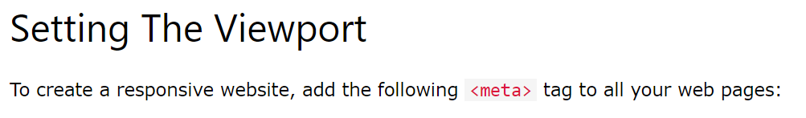
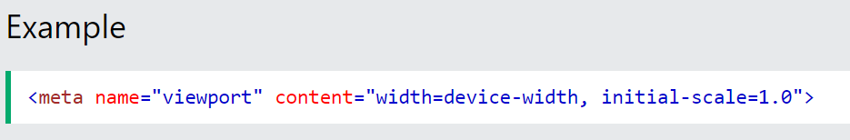
Responsive Web Design

Slide 63
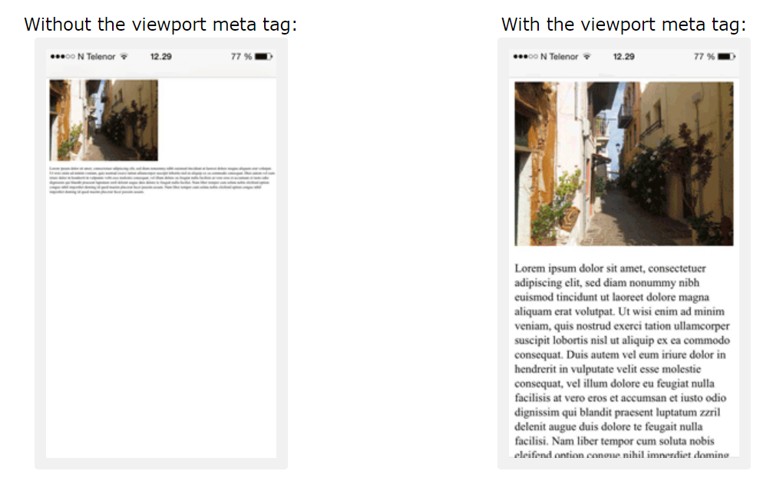
Responsive Web Design
This will set the viewport of your page, which will give the browser instructions on how to control the page's dimensions and scaling.
Here is an example of a web page without the viewport meta tag, and the same web page with the viewport meta tag:

Slide 64
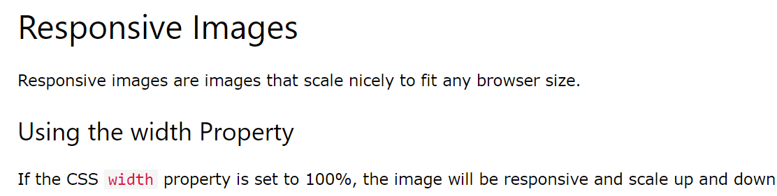

Responsive Web Design

Slide 65


Responsive Web Design

Slide 66


Responsive Web Design

Slide 67


Responsive Web Design

Slide 68
HTML Forms
15

Slide 69

HTML Forms
An HTML form is used to collect user input. The user input is most often sent to a server for processing.

Slide 70


HTML Forms
The <form> element is a container for different types of input elements, such as:
text fields,
checkboxes,
radio buttons,
submit buttons,
etc.

Slide 71

HTML Forms

Slide 72



HTML Forms

Slide 73



HTML Forms

Slide 74



HTML Forms

Slide 75



HTML Forms

Slide 76


HTML Forms
Tip:
If the action attribute is omitted, the action is set to the current page.

Slide 77



HTML Forms

Slide 78


HTML Forms

Slide 79


HTML Forms

Slide 80

HTML Forms
And many more…

Slide 81
HTML Multimedia
16

Slide 82

HTML ATTRIBUTES
Multimedia on the web is sound, music, videos, movies, and animations.

Slide 83

HTML Multimedia
Video
Formats

Slide 84

HTML Multimedia
Audio
Formats

Slide 85

HTML Multimedia
The HTML <video> element is used to show a video on a web page.
The controls attribute adds video controls, like play, pause, and volume.
It is a good idea to always include width and height attributes. If height and width are not set, the page might flicker while the video loads.
The <source> element allows you to specify alternative video files which the browser may choose from. The browser will use the first recognized format.
The text between the <video> and </video> tags will only be displayed in browsers that do not support the <video> element.

Slide 86


HTML Multimedia
To start a video automatically, use the autoplay attribute:

Slide 87

HTML Multimedia
The HTML <audio> element is used to play an audio file on a web page.
The controls attribute adds audio controls, like play, pause, and volume.
The <source> element allows you to specify alternative audio files which the browser may choose from. The browser will use the first recognized format.
The text between the <audio> and </audio> tags will only be displayed in browsers that do not support the <audio> element.

Slide 88



HTML Multimedia

Slide 89
HTML Emojis
17

Slide 90

HTML Emojis
Emojis are characters from the UTF-8 character set: 😄 😍 💗
To let the browser understand that you are displaying a character, you must start the entity number with &# and end it with ; (semicolon).

Slide 91


HTML Emojis
To let the browser understand that you are displaying a character, you must start the entity number with &# and end it with ; (semicolon).

Slide 92

HTML Emojis
Some Emoji Symbols in UTF-8 :

Slide 93

THANKS!

